Slide 1


Sign language recognition model based on multimodal inputs
AY 2021-25
GITAM UNIVERSITY
Major Project
Project ID: PROJ2999
A University should be a place of light, of liberty, and of learning.
Department of Electrical Electronics and Communication Engineering
Project Team:
DABBARA PRASHANTH
Project Mentor:
DR.CHINTOO KUMAR
DR.AVISHEK CHAKRABOTY
www.gitamedu.com

Slide 2

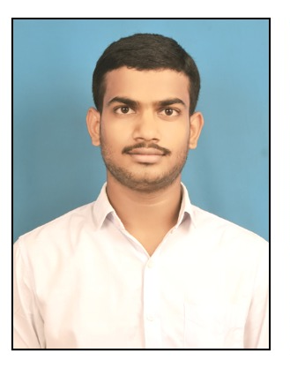
Project Group – Details
Photo
Track
Roll No
Name
EECE AI/ML
BU21EECE0100458
DABBARA PRASHANTH

Slide 3
Objective and Goals
Objective
Brief Description
Sign language identification model based on multimodal inputs.
Sign language recognition (SLR) plays a crucial role in bridging the communication gap between the deaf and hearing communities. Traditional SLR systems predominantly rely on visual inputs, primarily focusing on hand gestures. However, sign language is a complex form of communication that often involves multiple modalities, including facial expressions, body posture, and hand movements. To address these complexities, this paper proposes a sign language recognition model that leverages multimodal inputs to enhance accuracy and robustness. By integrating data from multiple sensors and applying advanced machine learning techniques, the proposed model effectively captures the nuances of sign language, leading to more reliable recognition. Experimental results demonstrate that the multimodal approach significantly outperforms unimodal systems, highlighting the potential of this method to advance SLR technologies and improve communication accessibility for the deaf community.
Goals
Main Goals
We consider a multimodal input where the video is basically a sign language-delivered video and the corresponding transcript is also taken into account for textual representation
Video could be depicted in a number of frames
These frames divide a picture into different boxes, and further, we do segmentation, localisation, Normalisation, and feature extraction to collect the preprocessed data
To build a model, we need to generate the embedding vectors corresponding to images and texts
In this regard, we made use of the Times former and DistilBERT model

Slide 4
Project Plan
Gant Chart - Milestones and Activities
Resources : https://www.officetimeline.com/gantt-chart/how-to-make/excel & https://www.teamgantt.com/
1. Data Collection*
- MULTIMODAL Inputs: Videos and Images*:
Data Curation : Collect a dataset of videos or images where each frame corresponds to a specific sign language postures. 2.Preprocessing
Frame Extraction: Downloaded videos further extracted into frames at a fixed rate.
-Normalization: Normalize the frames by resizing them to a consistent size and scaling pixel values.
- Data Augmentation: If requires to deal with data scarcity need to apply augmentation techniques like rotation, flipping, or noise addition to increase dataset diversity.
3. Embedding generation
Time s former and Distil bert models for videos and Text related Embedding generation
4. Modelling
The model requires performing a similarity search between these two forms of embedding vectors.

Slide 5
Literature Survey
Key Publications
Recent research emphasizes using multi-modal image fusion techniques to combine data from RGB cameras and depth sensors (like Kinect). The fusion of these images provides better feature representation for recognizing hand shapes and movements crucial in sign language.
Deep learning models, especially Convolutional Neural Networks (CNNs) and Recurrent Neural Networks (RNNs), are prominently used in image fusion for sign language recognition.
3D CNNs and Long Short-Term Memory (LSTM) networks are often used to capture both spatial and temporal features from fused images, enhancing the recognition accuracy for dynamic gestures.
Attention mechanisms are being incorporated to focus on important regions of the image that are crucial for sign recognition, such as hand regions and facial expressions.
Recent works have explored lightweight models and optimization techniques to run these systems on mobile devices and embedded platforms.
Key Resources – Whitepaper| Application Notes | Datasheet| Others
Recent Advances on Deep Learning for Sign Language Recognition
Towards Automatic Speech to Sign Language Generation

Slide 6
Existing Work-
The paper "Recent Advances on Deep Learning for Sign Language Recognition" is intended to give an overview of the recent progress made with deep learning techniques regarding the recognition and interpretation of sign language. It surely underlines how SLR is important in bridging the gap between deaf and hearing communities on grounds of communication. The paper highlights recent developments, especially models pertaining to deep learning, including CNNs, RNNs, and Transformers. It also took into consideration the difficulties related to the recognition of continuous sign language, including dataset expansion, and points out the critical use of mobile-friendly lightweight.

Slide 7
Analysis - SWOT
Strengths
Weaknesses
W1.Limited data availability
W2. User variability
W3. Resource intensive
W4. User variability
S1. Innovative and Inclusive Technology
S2. Increasing accessibility
S3.Strong market demand
S4.Potential for Real-time Applications
Threats
T1.Regularity Challenges
T2. Ethical Concerns
Opportunities
O1. Partnerships and Collaborations
02. Expanding Applications
O3. Potential for Patent
and Commercialization
04. Social Impact and Academic Recognition

Slide 8
Analysis – 4W1H
Why: Deaf and hearing communities, and researchers in sign language recognition.
What: A model for sign language recognition using multimodal inputs.
Where: Applicable in settings requiring communication between deaf and hearing individuals.
When: Relevant in the current technological and communication landscape.
How: By integrating multiple sensors and machine learning to enhance recognition accuracy.

Slide 9
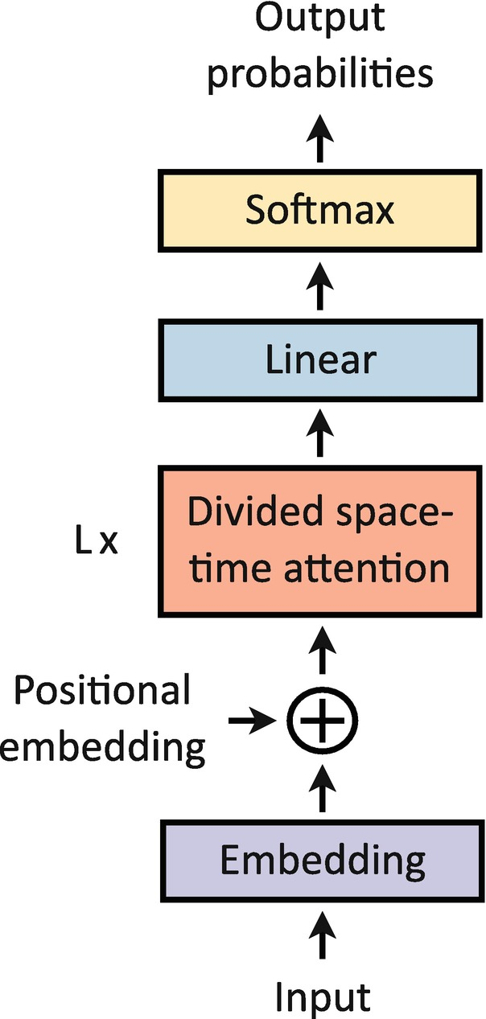
Architecture
Behaviour Diagram
Flow chart/ State machine
Resource - https://www.lucidchart.com/pages/examples/uml_diagram_tool
Times former
is a neural network architecture for video classification. It is based on the Transformer architecture, which has been highly successful in natural language processing tasks.
Structural Diagram
Block Diagram/Pin Diagram
Resource - https://www.lucidchart.com/pages/examples/uml_diagram_tool
The Time S former first projects input to embedding tokens, which are summed to positional embedding tokens. The resulting tokens are then passed through L divided space-time attention blocks and then linearly projected to obtain output probabilities.

Slide 10
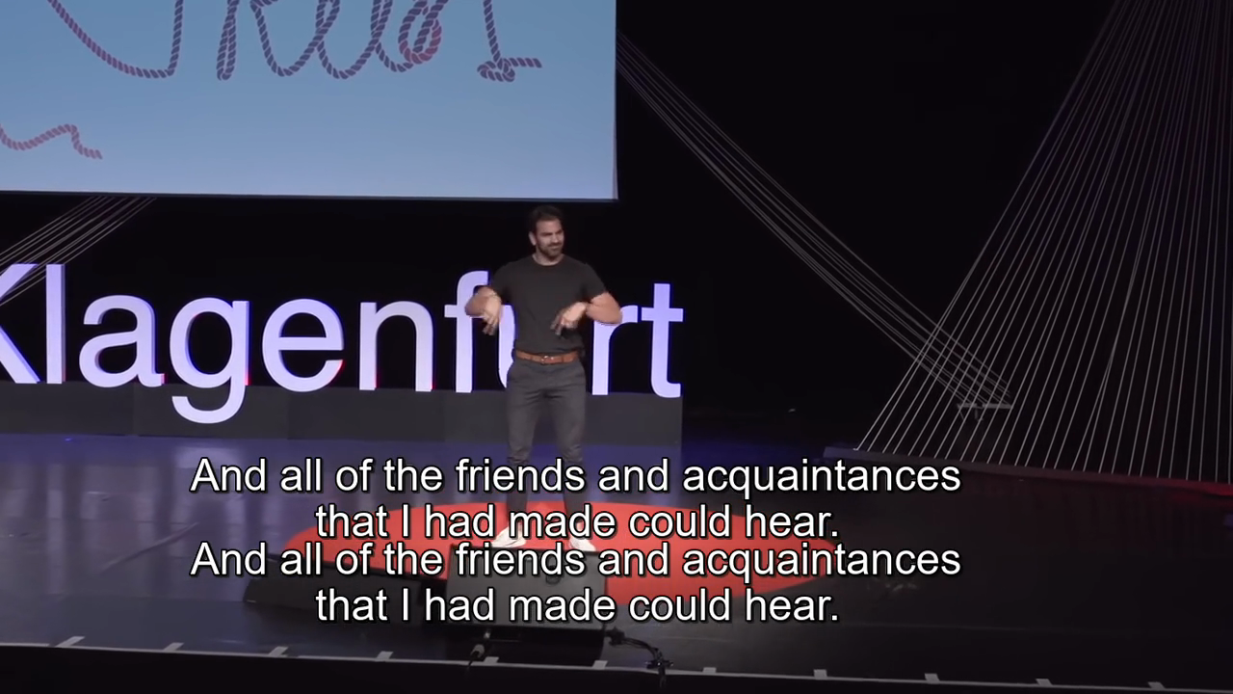
Implementation and Results
Iteration : Results + Validation against the use cases and test cases

Slide 11
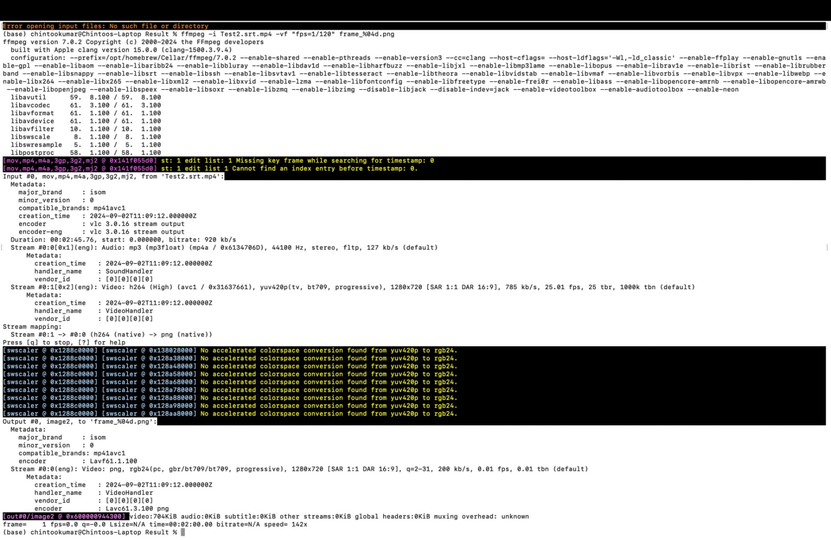

Slide 12
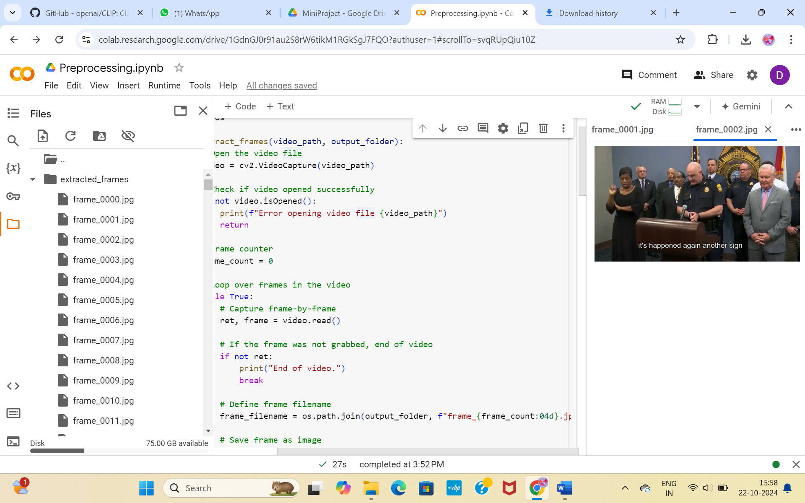
Contribution

Slide 13
Conclusion & Future Work
Future Work

Slide 14
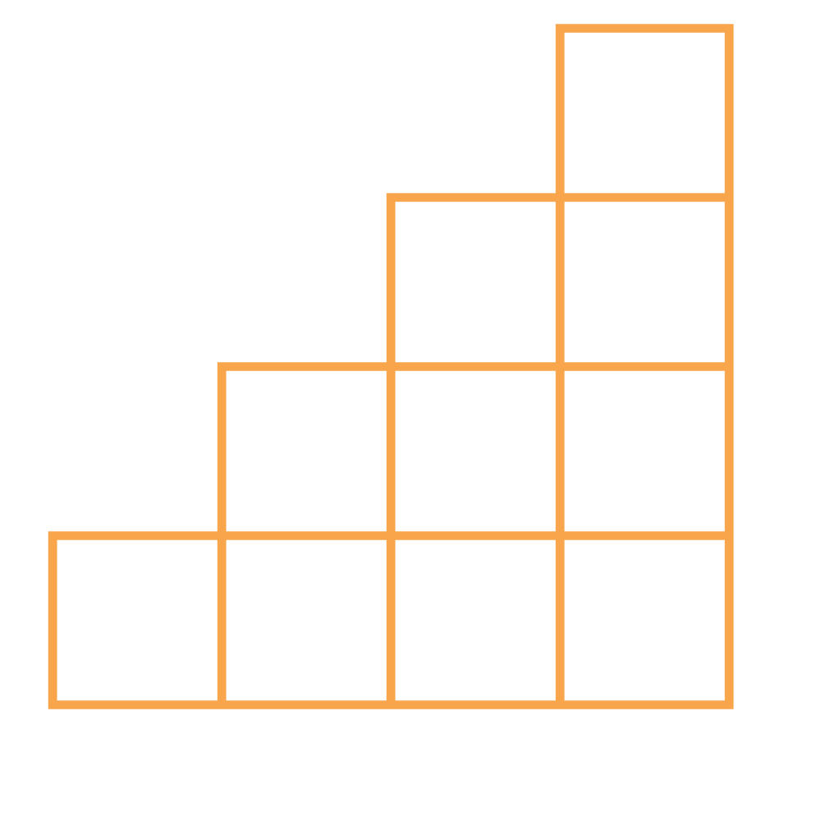
THANK YOU

